Slide 1
DEEPWATER HORIZON: BEHIND THE CURTAIN

Slide 12
Louisiana-style justice has been a disaster for BP
The Dallas Morning News – July 12, 2013 Joe Nocera:
So a group of lawyers persuaded their clients to skip the Feinberg process and sue BP. In March 2012, BP settled with those lawyers. As a condition for settling, the plaintiffs’ lawyers insisted that Feinberg be replaced by Patrick Juneau, a good-ol’-boy plaintiffs’ lawyer. BP also agreed to expand the potential universe of claimants, knowing full well that this would likely mean that people whose economic losses had no connection to the spill would receive “compensation.” It estimated that the settlement would cost it an additional $7.8 billion.
When London-based BP complained to Judge Carl Barbier, it got nowhere. Do I need to mention that Barbier is a former Louisiana plaintiffs’ lawyer? He was once the president of Louisiana Trial Lawyers Association. How cozy is that?
We like to talk about our belief in the rule of law, but the truth is that what is going on in Louisiana is not all that different from when a corrupt Russian official creates a fake tax liability to line his pockets at the expense of some hapless company. “This is Louisiana, after all,” a plaintiffs’ lawyer said recently. “A big foreign company with deep pockets, and you’re surprised there’s a feeding frenzy? Come on, man.”
Vladimir Putin couldn’t have put it better himself.

Slide 14
The Wall Street Journal – December 11, 2013 Would you pay this Claim? The Gulf Settlement Program did.
Claim XXXX89: A global nuclear consultant submitted a claim for lost income to the Gulf Settlement Program. The business has clients all over the world and performs services that could not possibly have been affected by the spill. The claim submitted also showed the company’s revenue and profits were higher in the year of the spill than any other year from 2007 to 2011. The claimant was awarded more than $510,000.
A claim from a company with a global business. For alleged losses in the company’s most profitable period in years. With no apparent connection to the spill. Paid in full.
How could this happen?
Despite these obvious red flags, the Gulf Settlement Program pushed this claim through to payment. Without adequate investigation or sufficient backup documentation. Indeed, the claimant even argued that whether it was affected by the spill is irrelevant. The fact is that thousands of undeserving claims like this – totaling over half a billion dollars – have already been paid.
We’ll continue fighting to stop all abuses of the settlement and return the claims process to doing what it was intended to do: paying the legitimate claims of people and businesses who suffered real financial losses from the spill.
For more, go to theStateoftheGulf.com.

Slide 16
PR Week – July 5, 2016 Political thrills and oil spills: How Geoff Morrell is helping BP take back its story
“To draw attention to the problem, BP took out full-page ads in The New York Times, The Washington Post, and The Wall Street Journal twice a week for several weeks – ‘which were very expensive, unconventional, and risky, because we were essentially the villain playing the victim,’ says Morrell. The ads got the attention BP desired, with coverage in Bloomsberg Businessweek and a big feature on 60 Minutes fronted by Morrell himself, which resulted in reforms within the system that significantly reduced the problem.”

Slide 17
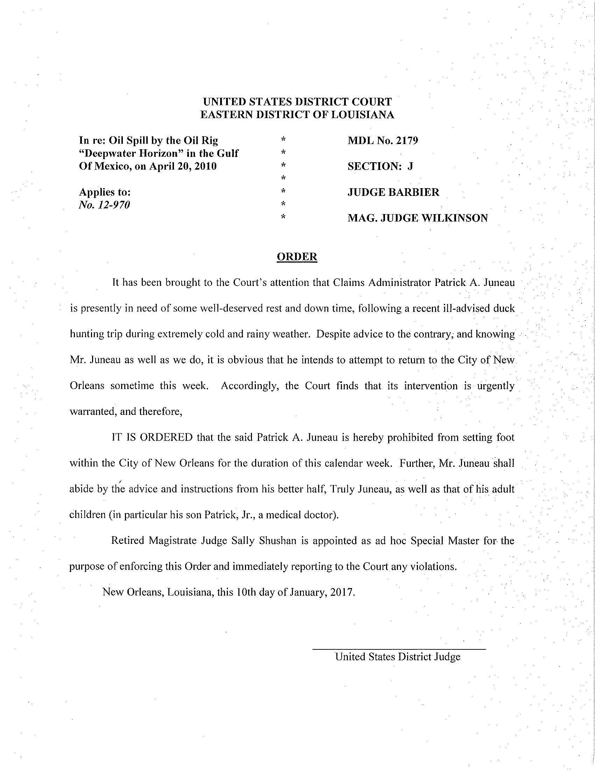

Slide 18
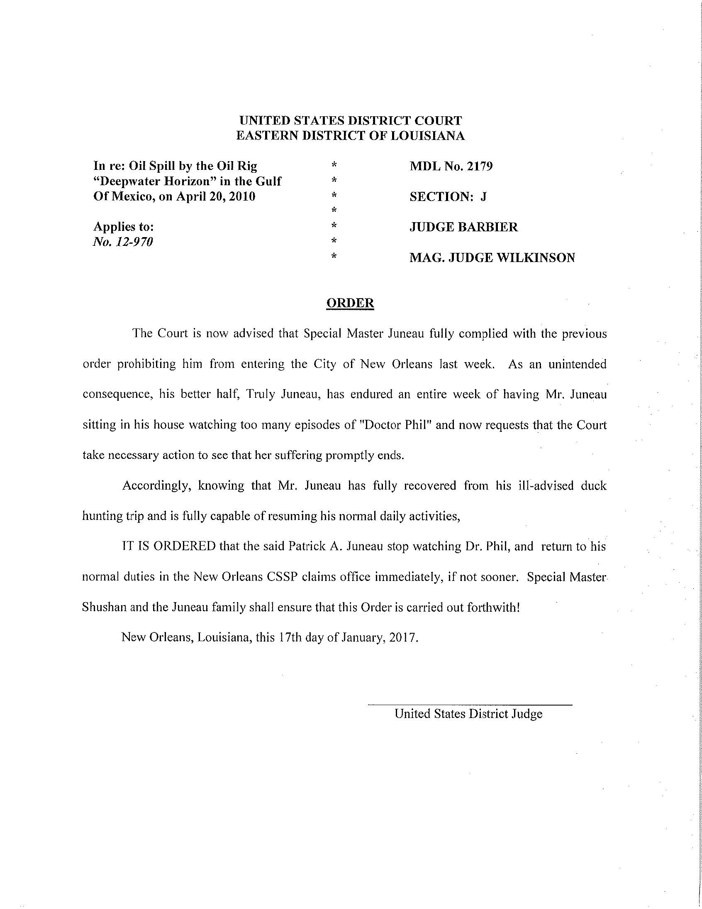

Slide 19
